Slide 1
Unbalanced Dataset Problem
© Dr. Umberto Michelucci - umberto.michelucci@toelt.ai
Dr. U. Michelucci
umberto.Michelucci@toelt.ai

Slide 2

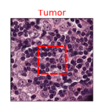
Problem Description – Classification in Practice (binary)
Classifier
Class: TUMOR
© Dr. Umberto Michelucci - umberto.michelucci@toelt.ai
Class: NOT TUMOR
Target Labels
Classes
…
Input Data
Algorithm
Image Source: Kolawole, P. (2022). Convolutional Neural Network for Detecting Cancer Tumors in Microscopic Images. Retrieved 19 March 2022, from https://medium.com/swlh/convolutional-neural-network-for-detecting-cancer-tumors-in-microscopic-images-1acab6481d05

Slide 3
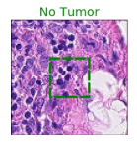
Problem Description – Classification in Practice (binary)
Classifier
Class: TUMOR
© Dr. Umberto Michelucci - umberto.michelucci@toelt.ai
Class: NOT TUMOR
Target Labels
Classes
…
Input Data
Algorithm
Image Source: Kolawole, P. (2022). Convolutional Neural Network for Detecting Cancer Tumors in Microscopic Images. Retrieved 19 March 2022, from https://medium.com/swlh/convolutional-neural-network-for-detecting-cancer-tumors-in-microscopic-images-1acab6481d05

Slide 4
Datasets in der Praxis (hospital-acquired infections)
683 patients
Class 0 (Infected): 75 (11% of the total)
Class 1 (healthy): 608 (89% of the total)
© Dr. Umberto Michelucci - umberto.michelucci@toelt.ai
Cohen, Gilles, et al. "Learning from imbalanced data in surveillance of nosocomial infection." Artificial intelligence in medicine 37.1 (2006): 7-18

Slide 5
Datasets in practice (Microsope images)
220,000 training images - 57,458 test images
© Dr. Umberto Michelucci - umberto.michelucci@toelt.ai
Class 0 (no Tumor)
55% of images
Class 1 (Tumor)
45% of images
Image Source: Kolawole, P. (2022). Convolutional Neural Network for Detecting Cancer Tumors in Microscopic Images. Retrieved 19 March 2022, from https://medium.com/swlh/convolutional-neural-network-for-detecting-cancer-tumors-in-microscopic-images-1acab6481d05

Slide 6
Unbalanced Dataset
Put simply, an dataset is said unbalanced when the target variable has more observations in a particular class than in the others.
© Dr. Umberto Michelucci - umberto.michelucci@toelt.ai

Slide 7
Unbalanced Dataset in Classification - Examples
Target Labels Distribution
© Dr. Umberto Michelucci - umberto.michelucci@toelt.ai
50%
50%
<1%
>99%
Balanced Dataset
Unbalanced
Dataset

Slide 8
Quiz
Starting situation
Dataset: 1000 inputs in Class 1 (e.g. no tumor); 10 in Class 0 (e.g. tumor)
Trained model achieved: 99% accuracy
Question: What do you think of the model? Is it good? Ultimately, it achieves 99% accuracy!
© Dr. Umberto Michelucci - umberto.michelucci@toelt.ai

Slide 9
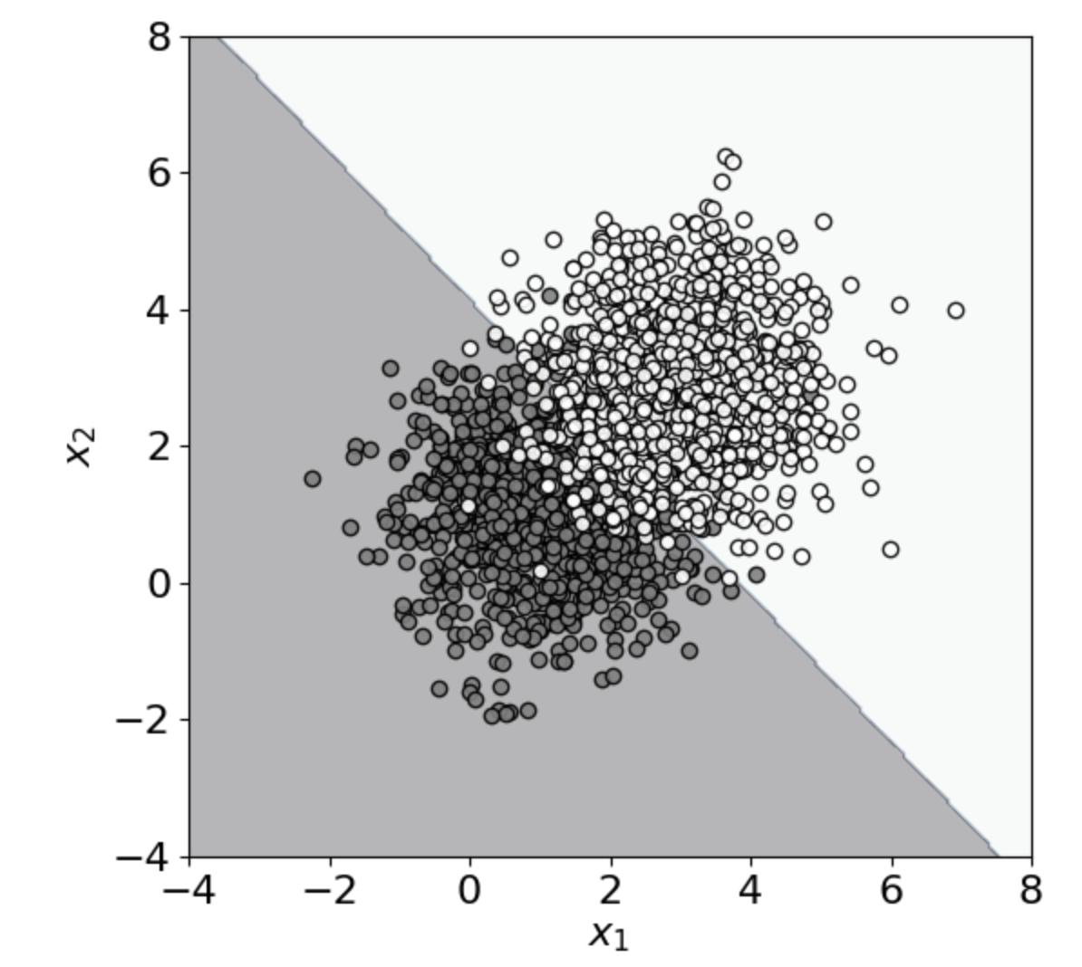
Unbalanced Dataset - Consequences
Class 1 (1000 points)
Class 0 (1000 points)
all points in this region are classified as Class 1
© Dr. Umberto Michelucci - umberto.michelucci@toelt.ai
Decision boundary
all points in this region are classified as Class 0
Approx. 91% accuracy is achieved (with linear support vector classifier)

Slide 10
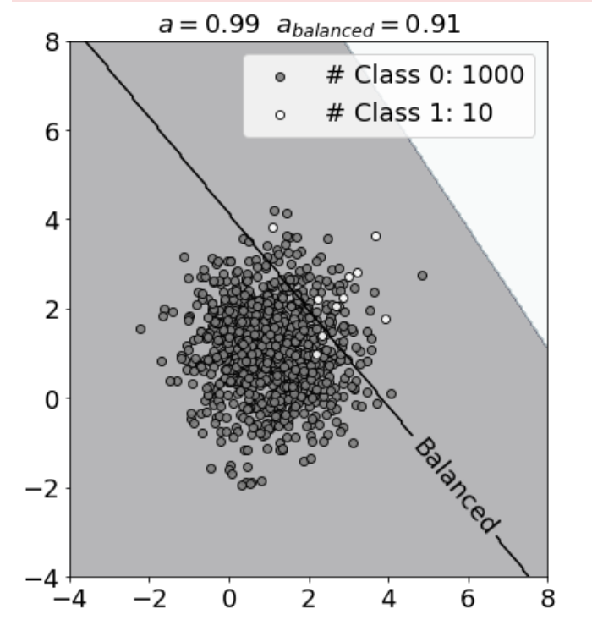
Unbalanced Dataset - Consequences
Class 1 (10 points)
Number of points in Class 1 is 1% Number of points in Class 0
Class 0 (1000 points)
all points in this region are classified as Class 1
Decision boundary with balanced dataset
© Dr. Umberto Michelucci - umberto.michelucci@toelt.ai
Decision boundary
all points in this region are classified as Class 0
Approx. 99% accuracy is achieved (with linear support vector classifier)

Slide 11
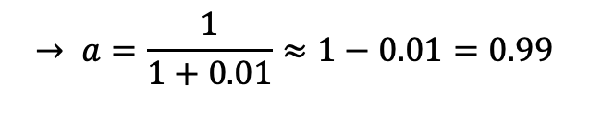
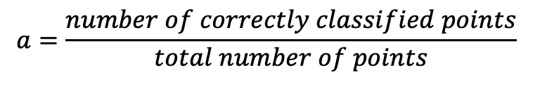
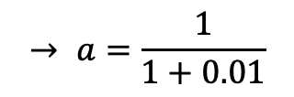
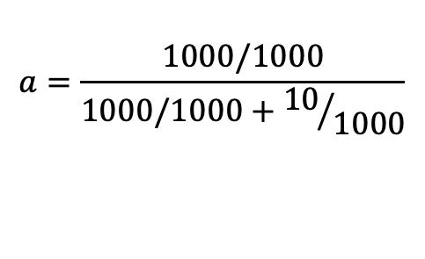
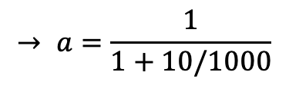
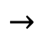
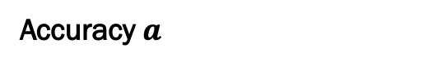
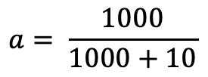
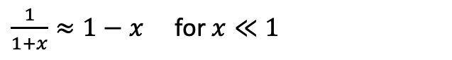
Unbalanced Dataset - Consequences
Number of points in Class 1 is 1% Number of points in Class 0
Class 1 (10 points)
Class 0 (1000 points)
Accuracy $a$
$$a=\frac{number of correctly classified points}{total number of points}$$
alle Punkte in dieser Region werden als Class 0 klassifiziert
$$a= \frac{1000}{1000+10}$$
$$a=\frac{1000/1000}{1000/1000+{10}/{1000}}$$
© Dr. Umberto Michelucci - umberto.michelucci@toelt.ai
$$→$$
$$→ a=\frac{1}{1+10/1000}$$
$$→ a=\frac{1}{1+0.01}$$
$$→ a=\frac{1}{1+0.01}≈1−0.01=0.99$$
Don't forget:
$\frac{1}{1+x}≈1−x$ for $x≪1$
Approx. 99% accuracy is achieved (with linear support vector classifier)

Slide 12
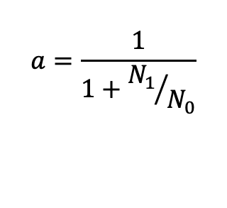
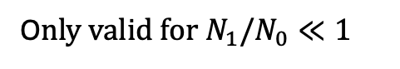
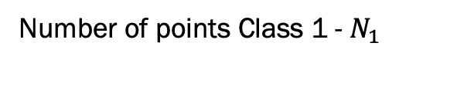
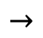
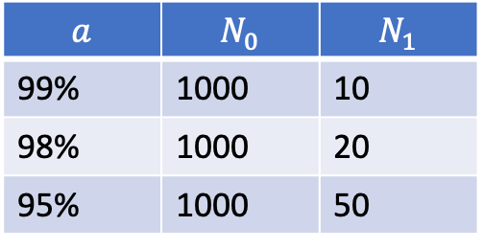
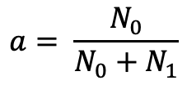
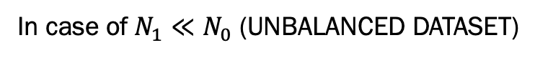
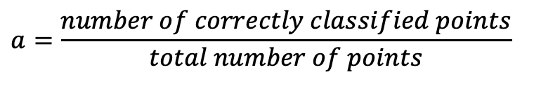
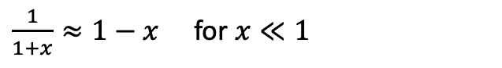
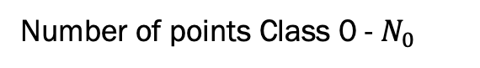
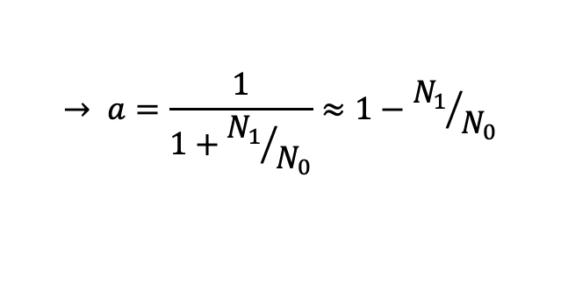
Unbalanced Dataset - Consequences
Number of points Class 1 - $N_{1}$
Number of points Class 0 - $N_{0}$
In case of$N_{1}≪N_{0}$ (UNBALANCED DATASET)
$$a=\frac{number of correctly classified points}{total number of points}$$
all points in this region are classified as Class 0
© Dr. Umberto Michelucci - umberto.michelucci@toelt.ai
$$a= \frac{N_{0}}{N_{0}+N_{1}}$$
$$a=\frac{1}{1+{N_{1}}/{N_{0}}}$$
$$→$$
$$→ a=\frac{1}{1+{N_{1}}/{N_{0}}}≈1−{N_{1}}/{N_{0}}$$
O$nly valid for N_{1}/N_{0}≪1$
$$a$$ | $$N_{0}$$ | $$N_{1}$$
99% | 1000 | 10
98% | 1000 | 20
95% | 1000 | 50
Don’t forget:
$\frac{1}{1+x}≈1−x$ for $x≪1$

Slide 13
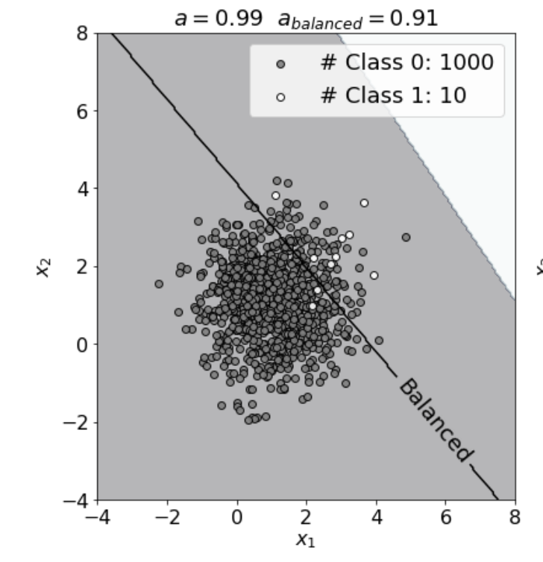
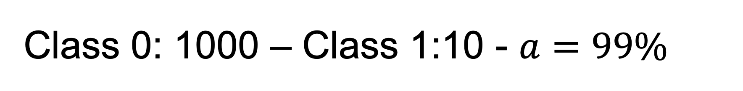
Class 0: 1000 – Class 1:10 - $a=99\%$
all points in this region are classified as Class 1
© Dr. Umberto Michelucci - umberto.michelucci@toelt.ai
Decision boundary
all points in this region are classified as Class 0

Slide 14
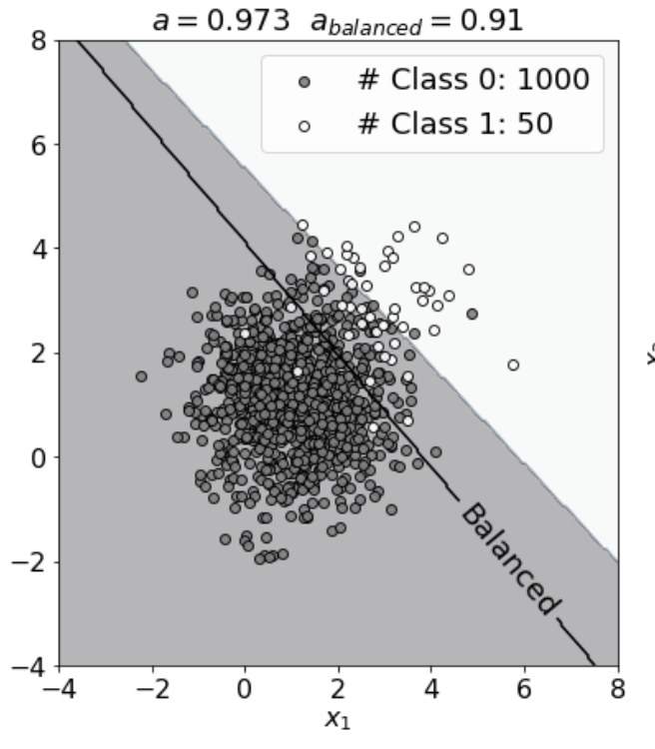
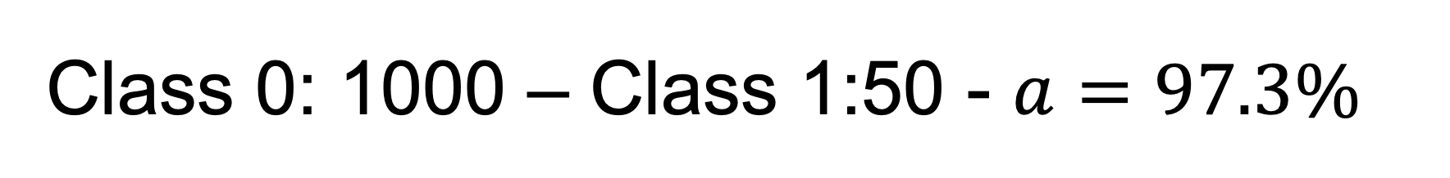
Class 0: 1000 – Class 1:50 - $a=97.3\%$
all points in this region are classified as Class 1
© Dr. Umberto Michelucci - umberto.michelucci@toelt.ai
Decision boundary
all points in this region are classified as Class 0

Slide 15
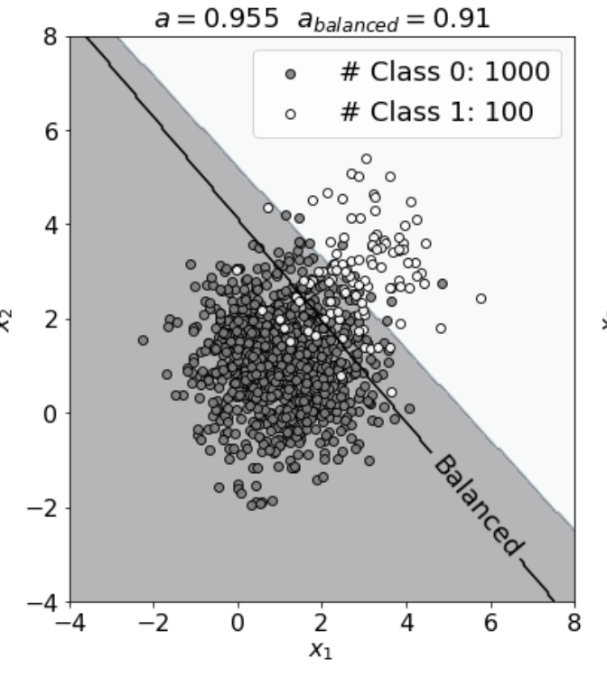
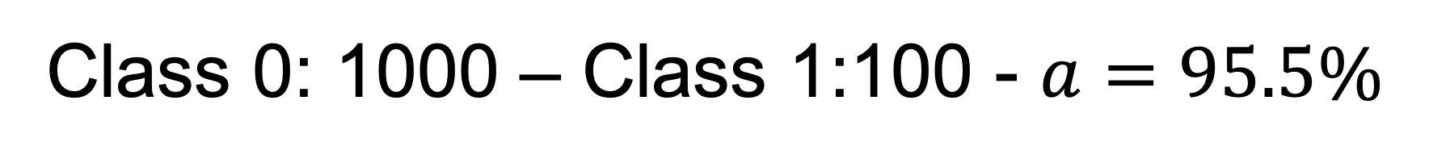
Class 0: 1000 – Class 1:100 - $a=95.5\%$
all points in this region are classified as Class 1
© Dr. Umberto Michelucci - umberto.michelucci@toelt.ai
Decision boundary
all points in this region are classified as Class 0

Slide 16
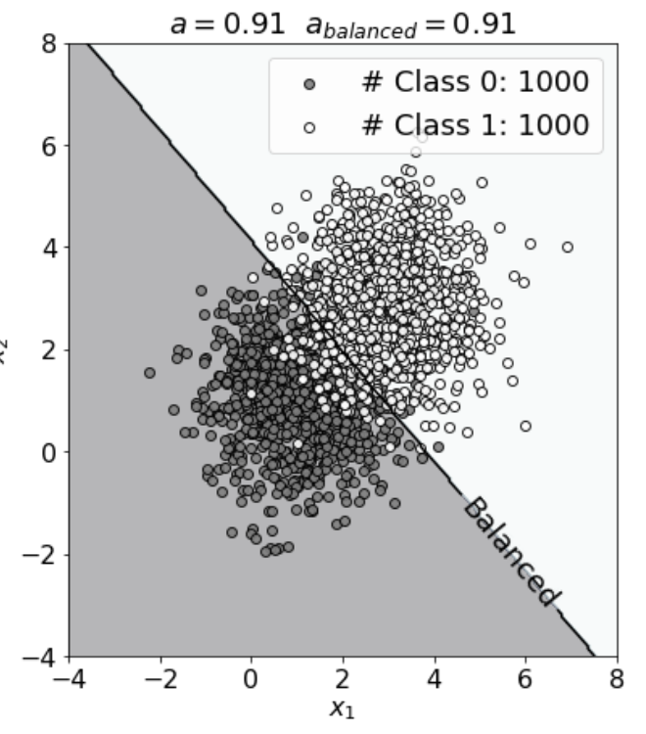
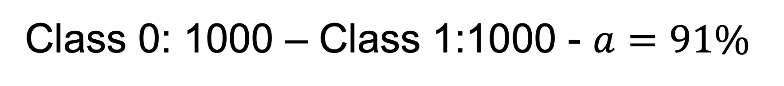
Class 0: 1000 – Class 1:1000 - $a=91\%$
all points in this region are classified as Class 1
© Dr. Umberto Michelucci - umberto.michelucci@toelt.ai
Decision boundary
all points in this region are classified as Class 0

Slide 17
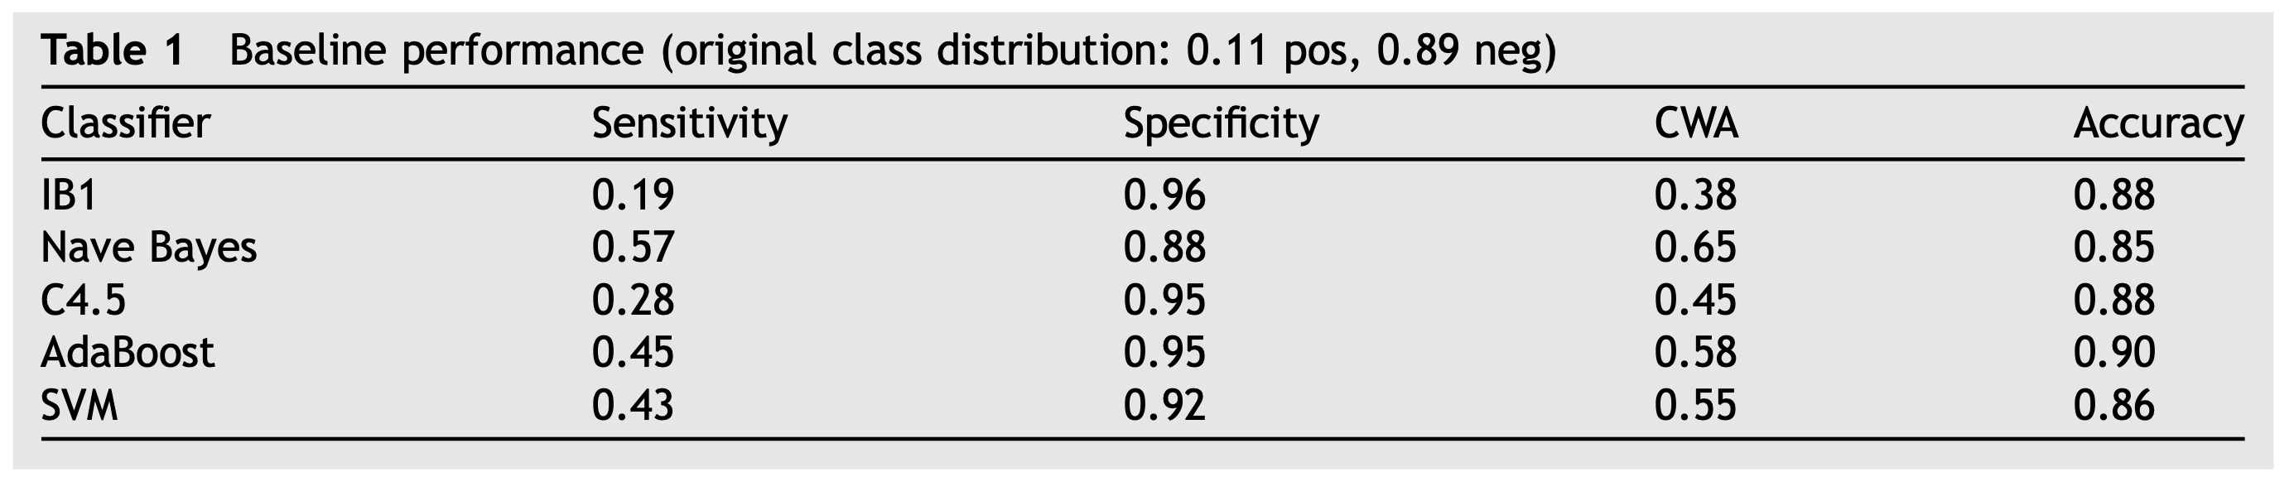
Real-life Scenario
Study on hospital-acquired infections: “Out of 683 patients, only 75 (11% of the total) were infected and 608 were not” (Cohen, Gilles, et al. "Learning from imbalanced data in surveillance of nosocomial infection." Artificial intelligence in medicine 37.1 (2006): 7-18)
(kNN)
(Decision Trees)
Sensitivity: the ability of a test to correctly identify patients with a disease
$$Sensitivity=\frac{TP}{P}=\frac{\text{"}\text{Number} \text{of} \text{inputs} \text{classified} \text{as}\text{ "}\text{sick}\text{" }\text{and} \text{have} \text{a} \text{true} \text{class} \text{of}\text{ "}\text{sick}\text{""}}{Number of sick patients}$$

Slide 18
Strategies for dealing with unbalanced data sets
Type 1 consists in the pre-processing of the data in order to restore the class balance. Type 2 consists of modifying the algorithms themselves so that they can handle unbalanced data.
Today we will deal with type 1.
© Dr. Umberto Michelucci - umberto.michelucci@toelt.ai

Slide 19
Unbalanced Dataset - Solutions
1) Collect more data on the less represented class
© Dr. Umberto Michelucci - umberto.michelucci@toelt.ai
2) Undersampling (subsampling) and oversampling
3) Use different metrics

Slide 20
Under- und Oversampling
© Dr. Umberto Michelucci - umberto.michelucci@toelt.ai

Slide 21
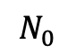
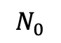
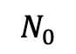
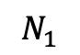
Oversampling
Class 0
Class 0
Class 1
© Dr. Umberto Michelucci - umberto.michelucci@toelt.ai
Class 1
Original Dataset
Oversampled Dataset
$$N_{0}$$
$$N_{1}$$
$$N_{0}$$
$$N_{0}$$

Slide 22
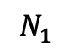
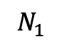
Undersampling (random undersampling)
Class 0
Class 0
Class 1
© Dr. Umberto Michelucci - umberto.michelucci@toelt.ai
Class 1
Original Dataset
Oversampled Dataset
$$N_{0}$$
$$N_{1}$$
$$N_{1}$$
$$N_{1}$$

Slide 23
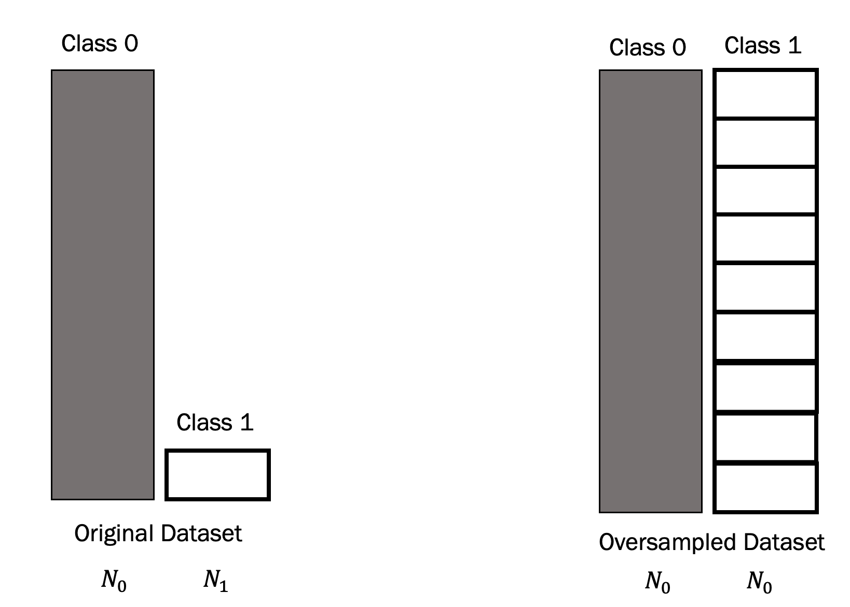
Advantages and disadvantages
Oversampling
Advantages:
You have a larger data set for training Disadvantages:
- The model generalizes worse because it has seen very few Class 1 cases
© Dr. Umberto Michelucci - umberto.michelucci@toelt.ai

Slide 24
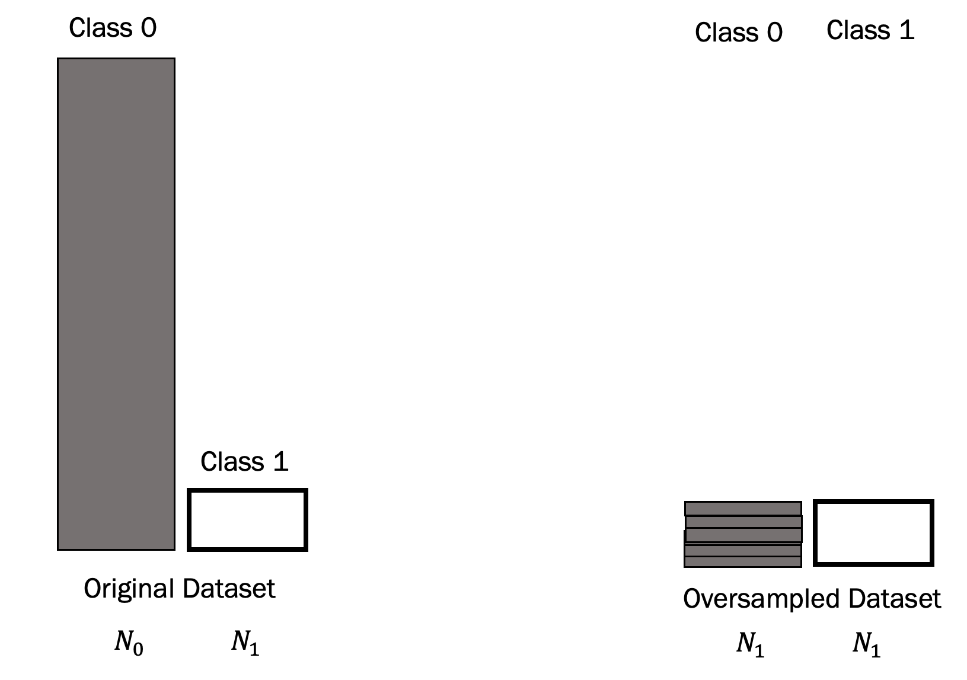
Advantages and disadvantages
Downsampling
Advantages:
You don't duplicate data
Disadvantages:
The training record is much smaller, and you lose a lot of data in class 0.
It can happen that the performance of the models quickly deteriorates with small data sets.
© Dr. Umberto Michelucci - umberto.michelucci@toelt.ai

Slide 25
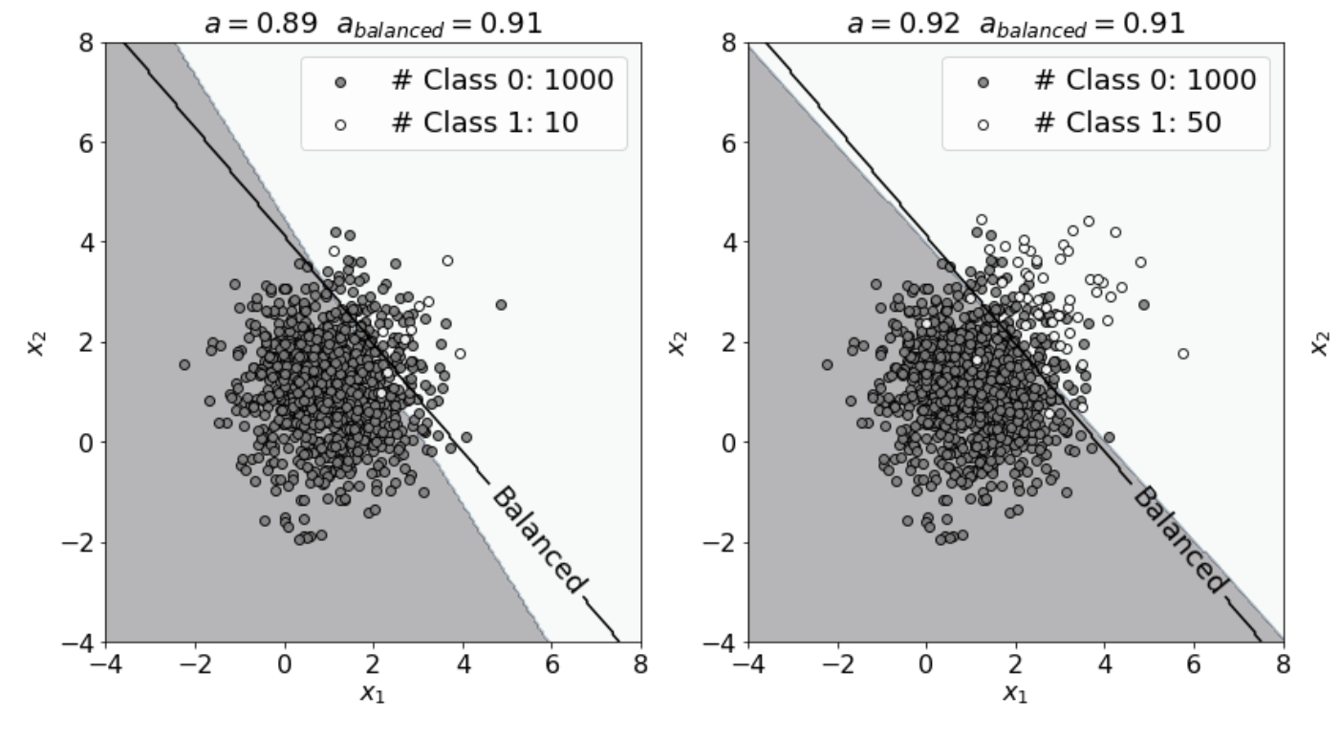
Oversampling
© Dr. Umberto Michelucci - umberto.michelucci@toelt.ai

Slide 26
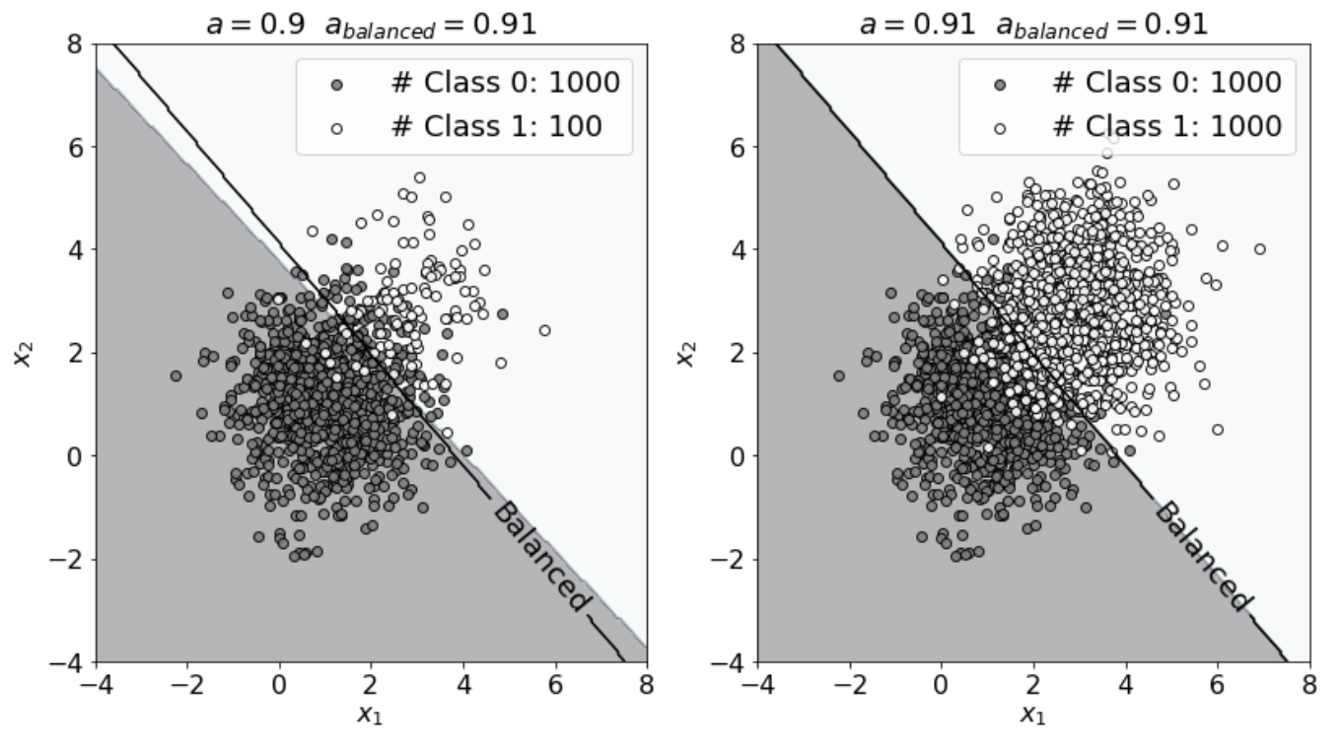
Oversampling
© Dr. Umberto Michelucci - umberto.michelucci@toelt.ai

Slide 27
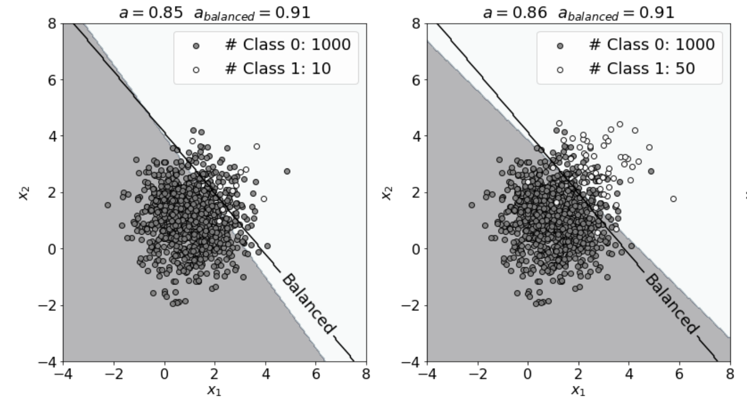
Undersampling
© Dr. Umberto Michelucci - umberto.michelucci@toelt.ai

Slide 28
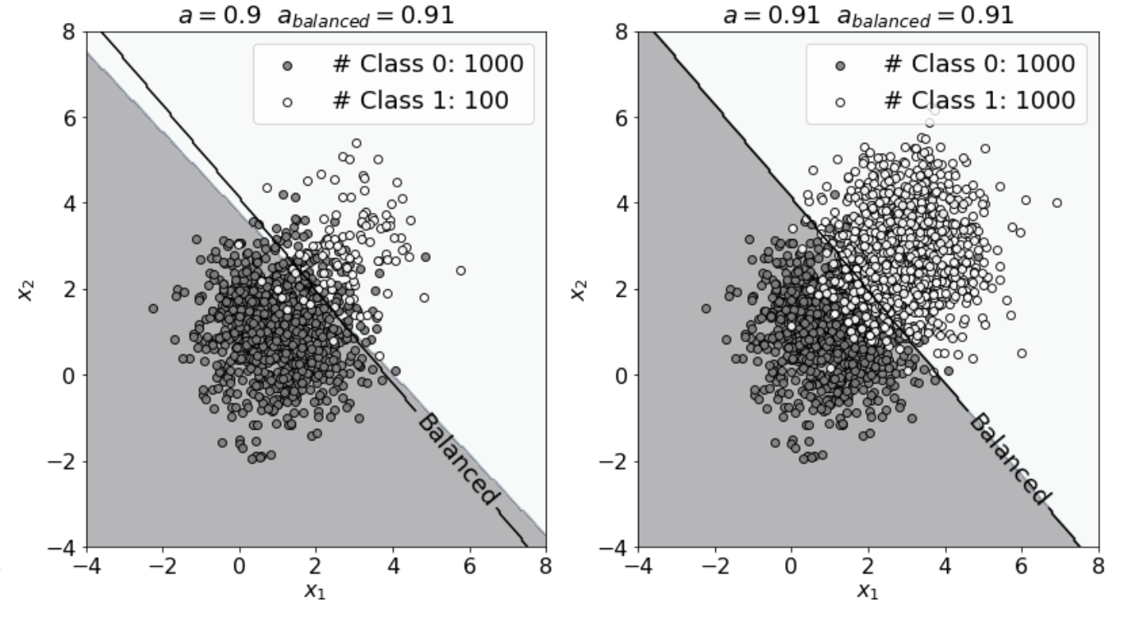
Undersampling
© Dr. Umberto Michelucci - umberto.michelucci@toelt.ai

Slide 29
Metrics for Unbalanced Dataset Scenarios
© Dr. Umberto Michelucci - umberto.michelucci@toelt.ai

Slide 30
Metrics - Overview
Binary Classification
Multi-class Classification
Metric | Discussed today | Metric | Discussed today
Accuracy | ü | Accuracy | ü
Specificity | ü | Accuracy pro class
Sensitivity | ü
Balanced Accuracy | ü
F1 Score | ü
Area Under The Curve (AUC / Receiving Operating Curve) | ü
© Dr. Umberto Michelucci - umberto.michelucci@toelt.ai
ü Confusion Matrix → Not really a metric (it contains multiple numbers)

Slide 31
Confusion Matrix (binary classification)
Number of inputs classified as 0 and that have a true class of 0 (TRUE POSITIVES, TP)
Number of inputs classified as 1 and that have a true class of 0 (FALSE NEGATIVES, FN)
In the case of the perfect classifier:
FN = 0 and FP = 0
True Label 0
© Dr. Umberto Michelucci - umberto.michelucci@toelt.ai
Number of inputs classified as 0 and that have a true class of 1 (FALSE POSITIVES, FP)
Number of inputs classified as 1 and that have a true class of 1 (TRUE NEGATIVES, TN)
True Label 1
Predicted Label 0
Predicted Label 1

Slide 32
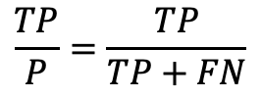
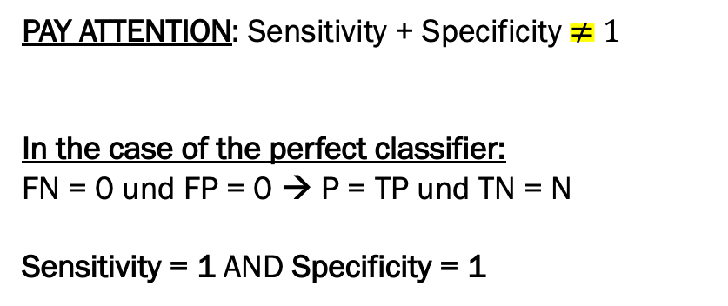
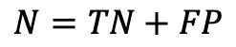
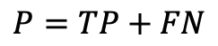
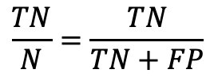
Sensitivity und Specificity
Sensitivity / Recall
True Positive Rate
$$\frac{TP}{P}=\frac{TP}{TP+FN}$$
How many of the cases in class 0 were correctly identified? "How many sick among all the sick have I identified?”
Specificity / selectivity
True Negative Rate
$$\frac{TN}{N}=\frac{TN}{TN+FP}$$
How many of the cases in Class 1 were correctly identified?
"How many healthy people among all healthy people have I identified?”
© Dr. Umberto Michelucci - umberto.michelucci@toelt.ai
Confusion Matrix
PAY ATTENTION: Sensitivity + Specificity $≠1$
In the case of the perfect classifier:
FN = 0 und FP = 0 → P = TP und TN = N
Sensitivity = 1 AND Specificity = 1
TP
FN
$$P=TP+FN$$
True Label
FP
TN
$$N=TN+FP$$
Predicted Label

Slide 33

Balanced Accuracy
Sensitivity / Recall
True Positive Rate
$$\frac{TP}{P}=\frac{TP}{TP+FN}$$
How many of the cases in class 0 were correctly identified?
"How many sick among all the sick have I identified?"
Specificity / selectivity
True Negative Rate
$$\frac{TN}{N}=\frac{TN}{TN+FP}$$
How many of the cases in Class 1 were correctly identified?
"How many healthy people among all healthy people have I identified?”
© Dr. Umberto Michelucci - umberto.michelucci@toelt.ai
Confusion Matrix
TP
FN
Balanced Accuracy = $a_{B}$ = $\frac{Sensitivity +Specificity}{2}$
$$P=TP+FN$$
True Label
FP
TN
$$N=TN+FP$$
Predicted Label

Slide 34

F1 Score
Sensitivity / Recall
True Positive Rate
$$\frac{TP}{P}=\frac{TP}{TP+FN}$$
How many of the cases in class 0 were correctly identified?
"How many sick among all the sick have I identified?"
Specificity / selectivity
True Negative Rate
$$\frac{TN}{N}=\frac{TN}{TN+FP}$$
How many of the cases in Class 1 were correctly identified?
"How many healthy people among all healthy people have I identified?”
© Dr. Umberto Michelucci - umberto.michelucci@toelt.ai
Confusion Matrix
TP
FN
F1 = $\frac{2}{\frac{1}{Sensitivity}+\frac{1}{Specificity}}$
$$P=TP+FN$$
True Label
FP
TN
$$N=TN+FP$$
Predicted Label
* harmonic mean

Slide 35

Summary – confusion matrix
© Dr. Umberto Michelucci - umberto.michelucci@toelt.ai

Slide 36


Class 0:1000 – Class 1:10 – Confusion Matrix
True Positives
False Negatives
= 100 %
© Dr. Umberto Michelucci - umberto.michelucci@toelt.ai
= 0 %
Balanced Accuracy
False Positives
True Negatives
$$a_{B}=50\%$$

Slide 37


Class 0:1000 – Class 1:50 – Confusion Matrix
True Positives
False Negatives
= 99.7 %
© Dr. Umberto Michelucci - umberto.michelucci@toelt.ai
= 50 %
Balanced Accuracy
False Positives
True Negatives
$$a_{B}=74.9\%$$

Slide 38


Class 0:1000 – Class 1:100 – Confusion Matrix
True Positives
False Negatives
= 98.9 %
© Dr. Umberto Michelucci - umberto.michelucci@toelt.ai
= 61 %
Balanced Accuracy
False Positives
True Negatives
$$a_{B}=80\%$$

Slide 39


Class 0:1000 – Class 1:1000 – Confusion Matrix
True Positives
False Negatives
= 91.2 %
© Dr. Umberto Michelucci - umberto.michelucci@toelt.ai
= 90.7 %
Balanced Accuracy
False Positives
True Negatives
$$a_{B}=91\%$$

Slide 40



Class 0:1000 – Class 1:10 – Confusion Matrix (mit vs. ohne Oversampling)
True Positives
False Negatives
False Negatives
True Positives
= 86.7 %
= 100 %
© Dr. Umberto Michelucci - umberto.michelucci@toelt.ai
= 90.6 %
= 0 %
Balanced Accuracy
Balanced Accuracy
False Positives
True Negatives
$$a_{B}=88.7\%$$
$$a_{B}=50\%$$
False Positives
True Negatives
WITH OVERSAMPLING
WITHOUT OVERSAMPLING

Slide 41

Real-life Scenarios
Study on hospital-acquired infections: “Out of 683 patients, only 75 (11% of the total) were infected and 608 were not” (Cohen, Gilles, et al. "Learning from imbalanced data in surveillance of nosocomial infection." Artificial intelligence in medicine 37.1 (2006): 7-18)
$$a_{B}$$
(kNN)
0.58
0.73
(Decision Trees)
0.62
0.70
0.68
* CWA – Class Weighted Accuracy (proposed in the paper)

Slide 42

Real-life Scenarios
Study on hospital-acquired infections: “Out of 683 patients, only 75 (11% of the total) were infected and 608 were not” (Cohen, Gilles, et al. "Learning from imbalanced data in surveillance of nosocomial infection." Artificial intelligence in medicine 37.1 (2006): 7-18)
(kNN)
(Decision Trees)

Slide 43
Example – Images and Neural Networks
© Dr. Umberto Michelucci - umberto.michelucci@toelt.ai

Slide 44
Question
Are neural networks smarter? Can they handle unbalanced records?
The goal is to convince you that what we've seen can happen with almost any algorithm.
© Dr. Umberto Michelucci - umberto.michelucci@toelt.ai

Slide 45

Problem Description
I want to develop a classifier that distinguishes the 1 from all the others.
# Number 1s: 6742 (11.2%)
# Number 0,2,3,4,5,6,7,8,9: ca. 53258 (88.8%)
© Dr. Umberto Michelucci - umberto.michelucci@toelt.ai
Handwritten digits – 28x28 pixel images

Slide 46
Confusion Matrix 1 vs. all (MNIST)
0
6742
True Label 1
© Dr. Umberto Michelucci - umberto.michelucci@toelt.ai
0
53258
True Label
0,2,3,4,5,6,7,8,9
* Not relevant: Results of a neural network with 1 neuron with sigmoid activation function.
Predicted Label
0,2,3,4,5,6,7,8,9
Predicted Label 1

Slide 47
Receiving Operating Curve (ROC)
The ROC curve is a very important method for studying binary classification metrics. It is used to derive the Area Under the Cruve (AUC) metric.
© Dr. Umberto Michelucci - umberto.michelucci@toelt.ai

Slide 48
ROC Curve (I)
An ROC curve (receiver operating characteristic curve) is a graph showing the performance of a classification model at all classification thresholds. This curve plots two parameters:
True Positive Rate (TPR)
False Positive Rate (FPR)
How can we draw the curve? A model has only one value for TPR and FPR!
© Dr. Umberto Michelucci - umberto.michelucci@toelt.ai
https://developers.google.com/machine-learning/crash-course/classification/roc-and-auc

Slide 49

ROC Curve (II) - Derivation
Let us suppose we have a model that has, as output, the probability ${\hat{y}}_{i}$ of an observation $x_{i}$ of being in class 1.
The input observation is classified according to the following rule¹⁾
$$\left\{\begin{aligned}Class 1 if {\hat{y}}_{i}>α \\ Class 0 if {\hat{y}}_{i}≤α\end{aligned}\right.$$
With $α∈[0,1]$ is a real number. Normally one chooses $α=0.5$.
© Dr. Umberto Michelucci - umberto.michelucci@toelt.ai
¹⁾ For the more mathematical savy of you, this is the translated Heaviside step function.

Slide 50




ROC Curve (III) - Derivation
For each value of $α$ one get a value of TPR$(α)$ and FPR$(α)$.
The ROC curve is obtained by plotting TPR$(α)$ and FPR$(α)$ by varying $α$ from 0 to 1.
$α=0$ – All observations
Classified as in class 1
$TPR=TP/P$ TP (True Positive) = P (Positive) → TP/ P = 1
© Dr. Umberto Michelucci - umberto.michelucci@toelt.ai
1
TPR
$α=1$ – All observations
Classified as in class 0
$TPR=TP/P$ TP (True Positive) = 0 (Positive) → TP/ P = 0
A value of $α$ between 0 and 1
1
FPR

Slide 51

ROC Curve (IV) – AUC (Area Under the Curve)
To get a general metric on all possible cases (or possible $α$), the area under the curve (indicated with A) is often given as a metric.
$α=0$ – All observations
Classified as in class 1
$TPR=TP/P$ TP (True Positive) = P (Positive) → TP/ P = 1
© Dr. Umberto Michelucci - umberto.michelucci@toelt.ai
1
TPR
$α=1$ – All observations
Classified as in class 0
$TPR=TP/P$ TP (True Positive) = 0 (Positive) → TP/ P = 0
A
A value of $α$ between 0 and 1
1
FPR

Slide 52
Metrics for Multi-Class Problems
Multiclass classification is the problem of classifying instances into one of three or more classes.
e.g. diabetes type I, II or "gestational".
© Dr. Umberto Michelucci - umberto.michelucci@toelt.ai

Slide 53
Metrics - Overview
Binary Classification
Multi-class Classification
Metric | Discussed today | Metric
Accuracy | ü | Accuracy | ü
Specificity | ü | Accuracy pro class
Sensitivity | ü
Balanced Accuracy | ü
F1 Score | ü
Area Under The Curve (AUC / Receiving Operating Curve) | ü
© Dr. Umberto Michelucci - umberto.michelucci@toelt.ai
ü Confusion Matrix → Not really a metric (it contains multiple numbers)

Slide 54
Confusion Matrix (Multi-class classification)
Number of inputs classified as 0 and that have a true class of 0
Number of inputs classified as 1 and that have a true class of 0
Number of inputs classified as 2 and that have a true class of 0
…
True Label 0
Number of inputs classified as 0 and that have a true class of 1
Number of inputs classified as 1 and that have a true class of 1
© Dr. Umberto Michelucci - umberto.michelucci@toelt.ai
True Label 1
…
…
…
…
…
Predicted Label 0
Predicted Label 1
Predicted Label 2

Slide 55

Quiz: Classifier is good or bad?
© Dr. Umberto Michelucci - umberto.michelucci@toelt.ai
Kwon, Hyun, et al. "Random untargeted adversarial example on deep neural network." Symmetry 10.12 (2018): 738.

Slide 56

Quiz: Classifier is good or bad?
© Dr. Umberto Michelucci - umberto.michelucci@toelt.ai
Oyedotun, Oyebade K., Djamila Aouada, and Bjorn Ottersten. "Improving the capacity of very deep networks with maxout units." 2018 IEEE International Conference on Acoustics, Speech and Signal Processing (ICASSP). IEEE, 2018.

Slide 57
Honorable Mention for Computer Vision Problems
© Dr. Umberto Michelucci - umberto.michelucci@toelt.ai
This really works

Slide 58
Data Augmentation
Especially in computer vision, data augmentation (a.k.a. generating new images from existing one, but slightly different) is a really powerful techniques that will make your model performance better! We will see it when we will discuss computer vision techniques.
© Dr. Umberto Michelucci - umberto.michelucci@toelt.ai

